Slide 1
Welcome Back – Part 4
Jerusalem Is Rebuilt
Ezra, Nehemiah, Esther, Haggai, Zechariah, Malachi

Slide 2
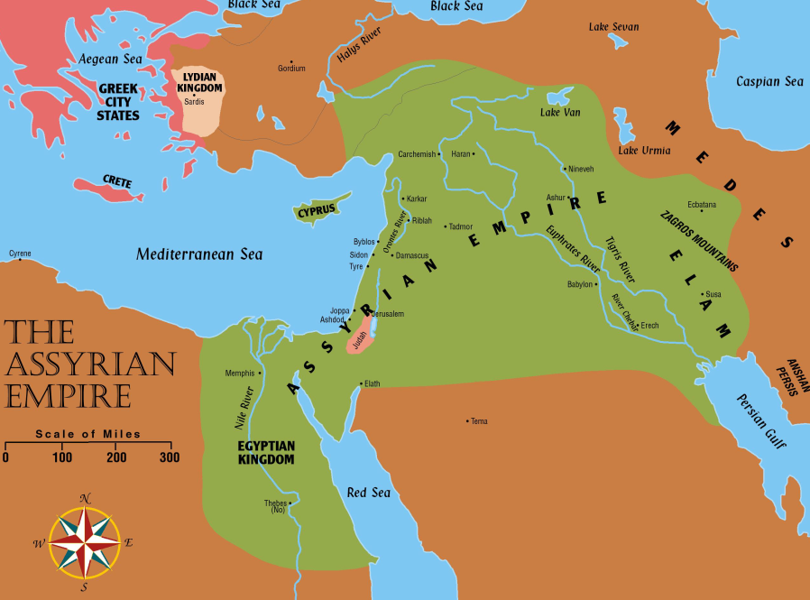
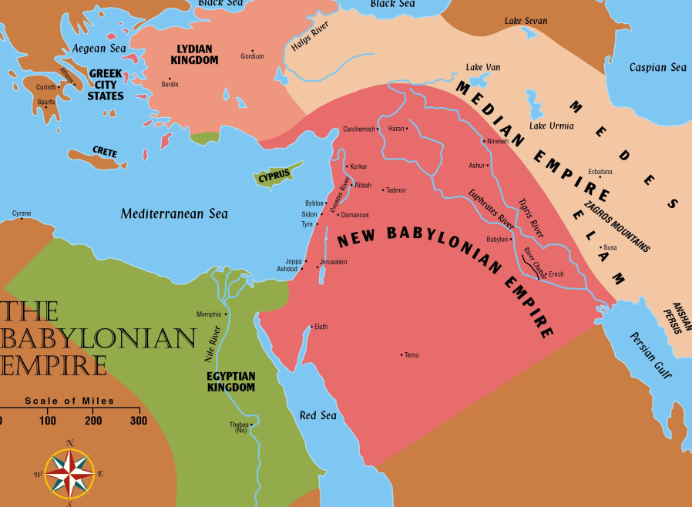
Jerusalem Is Rebuilt
Permission to go home included all the tribes of the Israelites. Ezra 1:3
  Israel (Northern tribes) was scattered throughout the Assyrian empire
  Judah (Southern tribes) scattered in Babylon

Slide 3
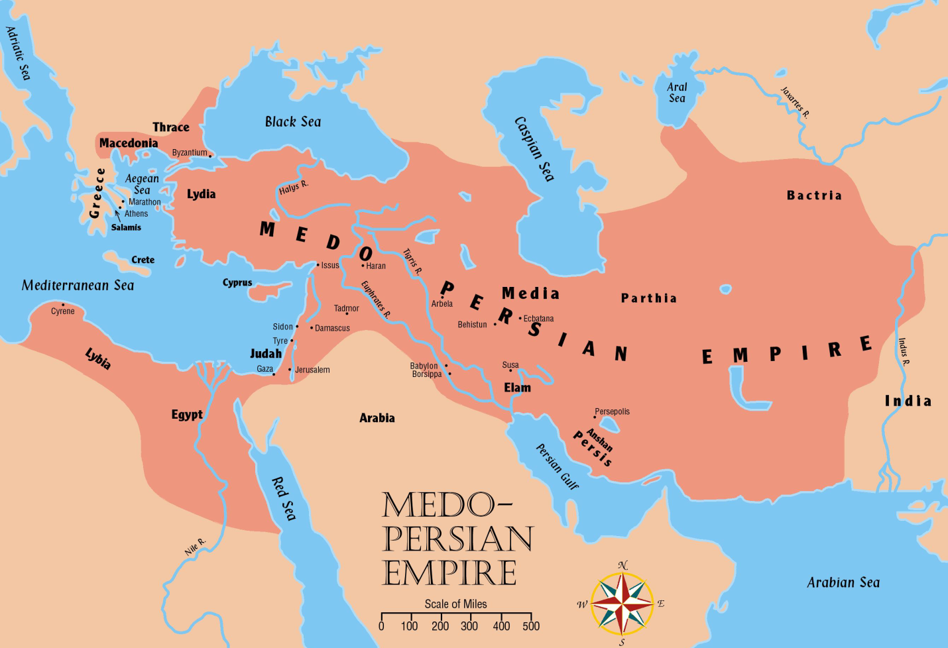
Jerusalem Is Rebuilt
Persia now controls all the territories once held by Assyrian and Babylonian empires

Slide 4
Captives Free to Return
536 BC
Many Israelites stayed where they were
  It has been almost 200 years since the first captives have been taken from Israel.
  721 BC
  The most recent captives have been gone 50 years
    They built homes and were content
    to stay
  It was their choice whether to return or not.

Slide 5
Captives Free to Return
536 BC
Approximately 50,000 Jews gathered in Babylon to start home (Ezra 2:64-65)
  Sheshbazzar (Ezra 1:8, 11; 5:14-15) and Zerubbabel (Ezra 2:2; 3:2,8; 4:3; 5:2) are named as leaders. (Perhaps same man)
  Many valuable vessels taken from the temple and palace in Nebuchadnezzar’s day are returned. Ezra 2:68-69
    5,400 gold and silver vessels returned
  Jews who stayed behind helped their brethren with gifts to make their trip easier. Ezra. 1
  It was a day of great joy as they began the trip
  However, the tasks ahead would not be easy

Slide 6
The People of Palestine
They profited from the Jews’ absence
  Samaritans, Ammonites, Edomites and Nomadic tribes moved into and nearer the
  fertile lands

Slide 7
The “three returns” in Ezra and Nehemiah:
Jews return home under the leadership of Zerubbabel to build the temple. (Book of Haggai) cf. Ezra 3:10ff; cf. Haggai 2:3
Ezra returns with the Priests to start the spiritual reform. Ezra 3
Nehemiah returns to build the walls. (Book of Nehemiah)
Adversaries: Samaritans desired to help build the temple. Ezra 4:1ff; Nehemiah 2:17ff;
cf. 2 Kings 17:32.
Jews accused of treason. Ezra 4:6ff; 11ff

Slide 8
Return Number ONE
Enemies wrote a letter to the new king Cambyses (Cyrus’ son) after Cyrus had died
Asked the king to check the records to see if Jerusalem had not always been rebellious. Ezra 4:15
  Cambyses checked and he found that Jerusalem had been rebellious. Ezra 4:17ff
  As a result, he had the work stopped and nothing more was accomplished for 16 years. Ezra 4:21
  The people built for themselves houses, yet did not prosper. Haggai 1:2-11

Slide 9
Return Number ONE
When king Darius the Great (Cyrus’ grandson) came to power, Haggai and Zechariah urged the people to resume work
  The people really needed this encouragement

Slide 10
Return Number ONE
A new letter is sent to the king telling the story of Jerusalem correctly (Ezra 5)
  Darius checked the records and found the original decree from Cyrus in the palace of Achmetha in Media
  He gave orders for the work to be finished and he forbade ANY opposition. (Ezra 6:1-2)
The temple was finished 20 years after it was begun
  A total of 4 years labor time (520-516 BC)

Slide 11
Esther
Takes place approximately between chapters 6 and 7 of the book of Ezra.

Slide 12
Haggai
“Consider Your Ways”

Slide 13
History – Haggai
Note four oracles are dated in this book that cover a period of four months:
1:1 In the second year of Darius, the sixth month, first day.
2:1 In the seventh month, twenty-first day.
2:10 In the ninth month, twenty-fourth day.
2:20 In the ninth month, twenty-fourth day.

Slide 14
History – Haggai
Date of the writing of Haggai. 1:1 (520 BC)
Darius I, reigned over Persia from 522 to 486 BC Therefore these four messages would have been delivered by Haggai about 520 BC, “in the second year of Darius the king” (1:1).
Sixteen years earlier (536 BC) 50,000 Jews had returned under the leadership of Zerubbabel.
(cf. Isaiah 44:24-45:7; Jeremiah 25:11)

Slide 15
History – Haggai
Haggai and Zechariah were sent to stir up the people and encourage them to complete the work. Ezra 5:1-2
Apathy. Haggai 1:2ff, “It is not the time (for us) to come, the time for Jehovah’s house to be built.”
  NOTE: Neither danger nor difficulty had prevented them from building their own luxurious houses.

Slide 16
Message 1 – The Time For Rebuilding The Temple Is Overdue. 1:1-15
Consider your ways! Literally, the prophet urged, “Set your heart upon your ways.”
  Work, but never satisfied.
    Without the Lord, contentment and lasting happiness is impossible. Haggai 1:6
  cf. Isaiah 5:8, 12; Proverbs 4:25-27
  Priorities were wrong. Proverbs 14:12; Jeremiah 10:23; cf. Matthew 6:33;
  1 Timothy 6:6-8; Philippians 4:6-7

Slide 17
Message 1 – The Time For Rebuilding The Temple Is Overdue. 1:1-15
Micah 6:7-8, “Will Jehovah be pleased with thousands of rams, (or) with ten thousands of rivers of oil? shall I give my first-born for my transgression, the fruit of my body for the sin of my soul? He hath showed thee, O man, what is good; and what doth Jehovah require of thee, but to do justly, and to love kindness, and to walk humbly with thy God?”
cf. Psalms 51:16-17

Slide 18
Message 1 – The Time For Rebuilding The Temple Is Overdue. 1:1-15
Response to this message. Haggai 1:12 -15
Remnant of the people obeyed and feared. “The fear of the Lord is the beginning of wisdom”
(Proverbs 9:10).
Spirit stirred.
Work started 23 days after the word was first delivered by Haggai (cf. 1:1 with 1:15)

Slide 19
Message 2 – Consolation To Those Who Remembered The Former Glory. 2:1-9
The Lord will be with the builders of the temple. 2:1-5
Anticipated disappointment. cf. Ezra 3:12
Splendor of Solomon’s temple. 1 Kings 6:22, 28, 30; 7:48-50
“Be Strong” – Strength not in numbers
(Deuteronomy 7:7-8; Judges 7; cf. Ephesians 6:10)
“Work” – cf. Nehemiah 4:6; Matthew 9:37-39
“I am with you.” cf. Matthew 28:20

Slide 20
Message 2 – Consolation To Those Who Remembered The Former Glory. 2:1-9
The Temple’s Future Glory. 2:6-9
Gifts received from:
  Cyrus (Ezra 1:7-11; 3:7)
  Darius (Ezra 6:9-13)
  Artaxerxes (Ezra 7:12-26)
  Other Gentiles. (Isaiah 60:5,11) Glorified Zion.
May be a type of the temple built by Christ.
(cf. Ephesians 2:21-22; 1 Corinthians 3:16-17; Hebrews 12:26-29)

Slide 21
Message 3 – Reply To Those Who Thought God’s Blessings Were Too Slow. 2:10-19
Israel needed to be cleansed. 2:10-14
  Can that which is unclean be made holy by coming in contact with that which is holy?
  NO! (cf. Leviticus 10:8-10)
  Can that which is clean be made unclean by coming in contact with that which is unclean? YES! (cf. Numbers 19:11,22)
Returning to the land, rebuilding the temple did not make them clean … needed a renewed attitude toward the Lord. Verse 14

Slide 22
Message 3 – Reply To Those Who Thought God’s Blessings Were To Slow. 2:10-19
Apathy had corrupted them.
Zeal for the Lord’s work would renew God’s blessings. 2:15-19
  Look from this day and backward 14-16 years to the present.
    God had not blessed them.
    cf. Amos 4:6-11
  Look from this day forward with a change of spirit to God’s blessings.

Slide 23
History
Work finished:
“And the elders of the Jews builded and prospered, through the prophesying of Haggai the prophet and Zechariah the son of Iddo. And they builded and finished it, according to the commandment of the God of Israel, and according to the decree of Cyrus, and Darius, and Artaxerxes king of Persia. And this house was finished on the third day of the month Adar, which was in the sixth year of the reign of Darius the king.” Ezra 6:14-15

Slide 24
Message 4 – The Lord Renews The Promise Of Salvation. 2:20-23
God rules in the kingdoms of men. 2:21-22
Prophets declared God’s promise to overthrow the “throne of kingdoms” and the “strength of the kingdoms of nations.”
Haggai repeats the prophecy of the shaking of the world. When this shaking takes place the throne of the kingdoms of men shall be thrown down, and the unshakeable kingdom of God shall be established. (Daniel 2:44; Hebrews 12:26-28)

Slide 25
Message 4 – The Lord Renews The Promise Of Salvation. 2:20-23
God rules in the kingdoms of men. 2:21-22
Messianic Hope Preserved In Zerubbabel. 2:23
  Make thee “as a signet,” (seal of authority).
  God did keep His promise to Zerubbabel because he is a direct descendant of David (2 Samuel 7:11-14) and an ancestor of Jesus in the flesh
  (Matthew 1:12-13; Luke 3:27).
    If Jesus were to reign on earth in Judah, the prophecies of Jeremiah and Haggai would become invalid. Such will not happen.

Slide 26
Application
God blesses those who put Him first.
Matthew 6:19-20, 33; Luke 12:16-21;
Luke 14:16-24

